Slide 1
Learning Rate in Neural Networks
Notes:
Click to add Notes

Slide 2
What is Learning Rate?
- A hyperparameter
- Controls weight updates
- Defines step size during training
- Controls how fast model learns
- Learning rate is critical for model training.
- It controls stability and speed of learning.
Notes:
Click to add Notes

Slide 3
How it works
Weight update:
New weight = Old weight - (Learning Rate × Gradient)
Notes:
Click to add Notes

Slide 4
Low Learning Rate
- Very slow learning
- Needs many epochs
- Risk of underfitting
- Loss decreases slowly
Notes:
Click to add Notes

Slide 5
High Learning Rate
- Fast but unstable
- Loss may fluctuate
- May overshoot optimal solution
Notes:
Click to add Notes

Slide 6
Good Learning Rate
- Stable learning
- Smooth convergence
- Common value: 0.001 (Adam)
Notes:
Click to add Notes

Slide 7
Example from our model
Adam optimizer
Learning rate = 0.001
Train Accuracy ~90%
Validation accuracy ~88%
Notes:
Click to add Notes

Slide 8
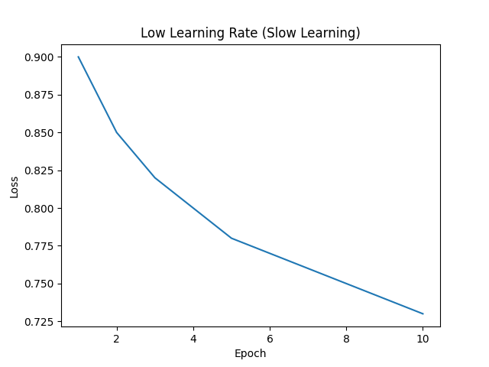
Low Learning Rate
Notes:
Click to add Notes

Slide 9
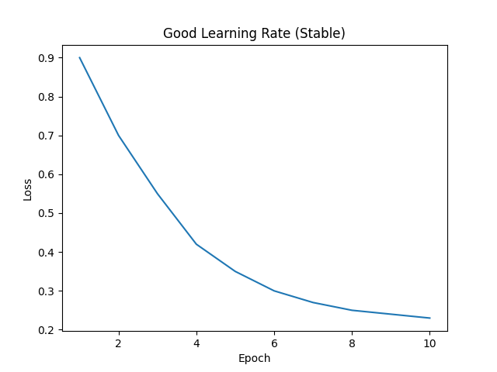
Good Learning Rate
Notes:
Click to add Notes

Slide 10
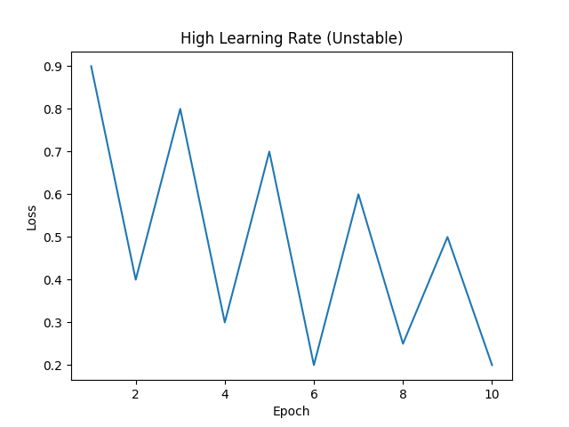
High Learning Rate
Notes:
Click to add Notes

Slide 11
Summary
Too low → slow learning
Too high → unstable
Balanced → best performance
Notes:
Click to add Notes

